Slide 1
The Next 700 Programming Languages
Notes:
By Peter Landin in 1965

Slide 2
If you See What I Mean
Notes:
A lambda-calculus based functional programming language

Slide 3
Intro
An attempt at general purpose system for describing things in terms of other things
Any uses of a user-coin name implicitly involve a functional relation
Notes:
For example, in almost every language a user can coin names, obeying certain rules about the contexts in which the name is used and their relation to the textual segments that introduce, define, declare, or otherwise constrain its use. These rules vary considerably from one language to another, and frequently even within a single language there may be different conventions for different classes of names, with near-analogies that come irritatingly close to being exact.
So rules about user-coined names is an area in which we might expect to see the history of computer applications give ground to their logic. Another such area is in specifying functional relations. We can see by comparing these two

Slide 4
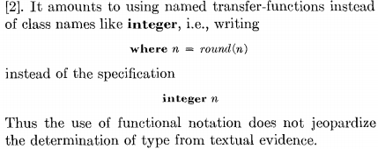
The Where Notation
Linguistic Structure -- qualified by where-clause
Syntax -- acceptable configuration
Semantic Constraints on linguistic structure
transfer -functions instead of class name
Notes:
A part of where definition -- where clause
Where are brackets optional or obligatory
Meanings that are appropriate for main clause
Outcome of more recondite structural configuration among those deemed admissble

Slide 5
Physical ISWIM and Logical ISWIM
Four-level concept:
Physical ISWIM -- reference language and publication and hardware language
Logical ISWIM -- Uncommitted as to character sets and type faces but committed as to the sequence of textual elements and grammatical rules
Abstract ISWIM -- “Tree Language”, committed to the grammatical categories and their nesting structure
Applicative Expression -- another tree language, more austere
1+2 or 2+3 -- syntax or grammar of language
Without a physical representation -- “Logical ISWIM”
It grafts procedural notions onto a purely functional base without disturbing many of the desirable properties
Notes:
The relationship between physical ISWlM and logical ISWIM is fixed by saying what physical texts represent each logical element, and also what layout is permitted in stringing them together
The relationship between logical Isw~ and abstract IswlM is fixed by a formal grammar not unlike the one in the ALGOL 60 report, together with a statement connecting the phrase categories with the abstract grammatical categories
The relationship between abstract Iswls( and AEs is fixed by giving the form of AE equivalent to each abstract IswiM grammatical category. It happens that these latter include a subset that exactly matches AEs. Hence this link in our chain of reh~tions is roughly a mapping of ISWIM into an essential "kernel" of IswIM, of which all the rest is mere decoration.

Slide 6
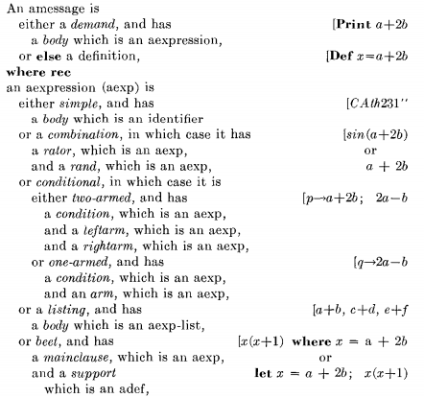
Abstract ISWIM
The texts of abstract ISWIM are composite information structures called amessage’s
Notes:
The following defines the class in terms of a class called identifier
Examples of Reference ISWIM are given alongside, against the right margin

Slide 7
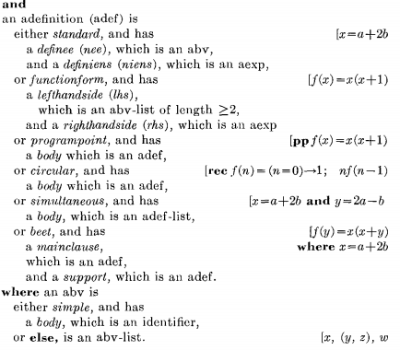
Abstract ISWIM
A program-point definition introduces a deviant kind of function.
Applying such a function precipitates premature termination of the where-expression containing it, and causes its result to be delivered as the value of the entire where-expression

Slide 8
Relationship to LISP
No particular problem orientation
Outside a certain subset, ISWIN needs garbage collection(dynamic storage collection and LIFO)
Illuminate dark corners of LISP
Different textual appearance
Let or Where
Infixed operators
Indentation
Similar Logical properties
Notes:
No bias towards or away from a particular field of application has emerged.
It is nearer to LISP'S M-expressions (which constitute an informal language used as an intermediate result in hand-preparing LISP programs). IswlAi has the following additional features:

Slide 9
Equivalence Rules
Subexpression
User-coined names
Built-in entities
Named entities
Notes:
the extent to which a subexpression can be replaced by an equivalent subexpression without disturbing the equivalence class of the whole expression.
user-coined names, i.e., in definitions and, in particular, function definitions. (3) built-in entities implicit in special forms of expression. The only iiistanees of this in Iswllv[ are conditional expressions, listings and self-referential definitions. (4) named entities added in any specific problemorientation of IswIM.

Slide 10
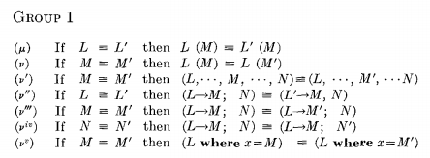
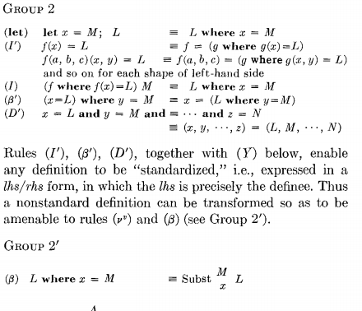
Notes:
Substitute M for x throughout L
Fruitful development in fruitful are in which imperative expression can be disregarded

Slide 11
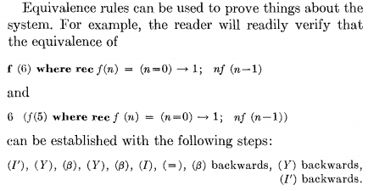
Equivalence Rules

Slide 12
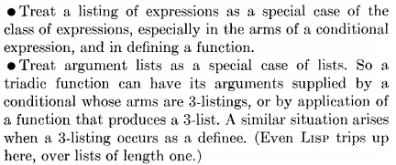
Explicit Sequencing
The two most needed features:
Reducing the extent to which the program conveys its information by explicit programming
Adding imperative feature to basically non imperative language. Resulting language will have non imperative subset
Notes:
Roughly speaking this amounts to using fewer and larger statements.
easier to understand, debug, modify and incorporate into a larger program
User of programming language is often presented with a choice between using explicit sequencing or some alternative feature of the language
an emphasis on describing things in terms of other things leads to the same kind of requirements as an emphasis against explicit sequencing.

Slide 13
Final point
Do the idiosyncracies reflect basic logical properties of the situations that are being catered for? Or are they accidents of history and personal background that may be obscuring fruitful developments?
Notes:
At the conclusion, the author proposed two important problem for prediction of future language evolution
three techniques of language design: abstract syntax, axiomatization, and an underlying abstract machine. It is assumed that future calls on language development cannot be forestalled without gener~lizing the alternatives to explicit sequencing. The innovations of "programpoints" and the "off-side rule" are directed at two of the problems (respectively in the areas of semantics and syntax) that must consequently be faced.
The languages people use to communicate with computers differ and we want to know if this reflect basic logical properties

Slide 14
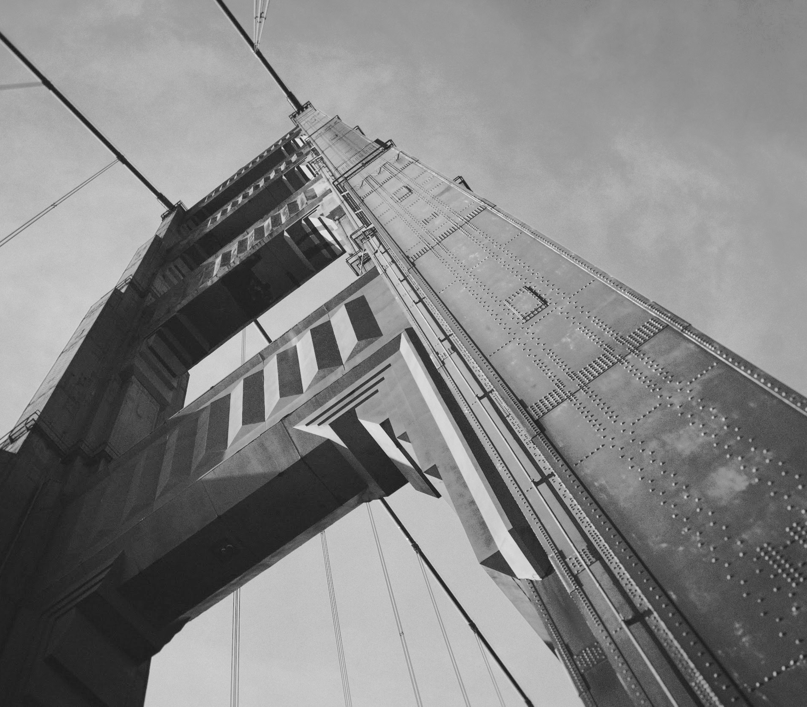
Thanks!

